Slide 1
Laravel5, Webpack, ReactJS Bootcamp
Sonny Recio | Fullstack Web Developer (MS Technologies)

Slide 2

Meet Sonny Recio | ‏@yellowflashdev
Fullstack Web Developer
Specializes in MS technologies such as ASP.net MVC for 5 years
Well-versed in using front-end technologies such as Javascript, ReactJS, Redux, Redux Saga
Practitioner of TDD
Other specialties
IT consultant
Blogger / Article Writer
Productivity hacker

Slide 3
Bootcamp Topics
Part 1: Introduction
01 | What is Javascript?
02 | The challenge of Modern Web Development
03 | The solution to Modern Web Development
04 | What is Webpack

Slide 4
Bootcamp Topics (cont.)
Part 2: Jumpstart with ReactJS
01 | What is ReactJS? | 06 | The basics of React
02 | What is React trying to solve? | 07 | Quickstart with building React applications
03 | ReactJS Philosophy | 08 | Creating our first React Component
04 | Pros of using React | 09 | Developing CRUD apps using ReactJS
05 | Cons of using React

Slide 5
Bootcamp Topics (cont.)
Part 3: Where to go from here?(after hackathon)
01 | Q & A Session
02 | Recommended resources for self-paced learning
03 | Recommended courses for ReactJS, Laravel, Webpack
04 | Advices for developers

Slide 6
Part 1: Introduction

Slide 7
What is JavaScript?

Slide 8
What is JavaScript
JavaScript (JS) is a lightweight interpreted or JIT-compiled programming language with first-class functions. While it is most well-known as the scripting language for Web pages
JavaScript is a prototype-based, multi-paradigm, dynamic language, supporting object-oriented, imperative, and declarative (e.g. functional programming) styles.
Source: https://developer.mozilla.org/en-US/docs/Web/JavaScript

Slide 9
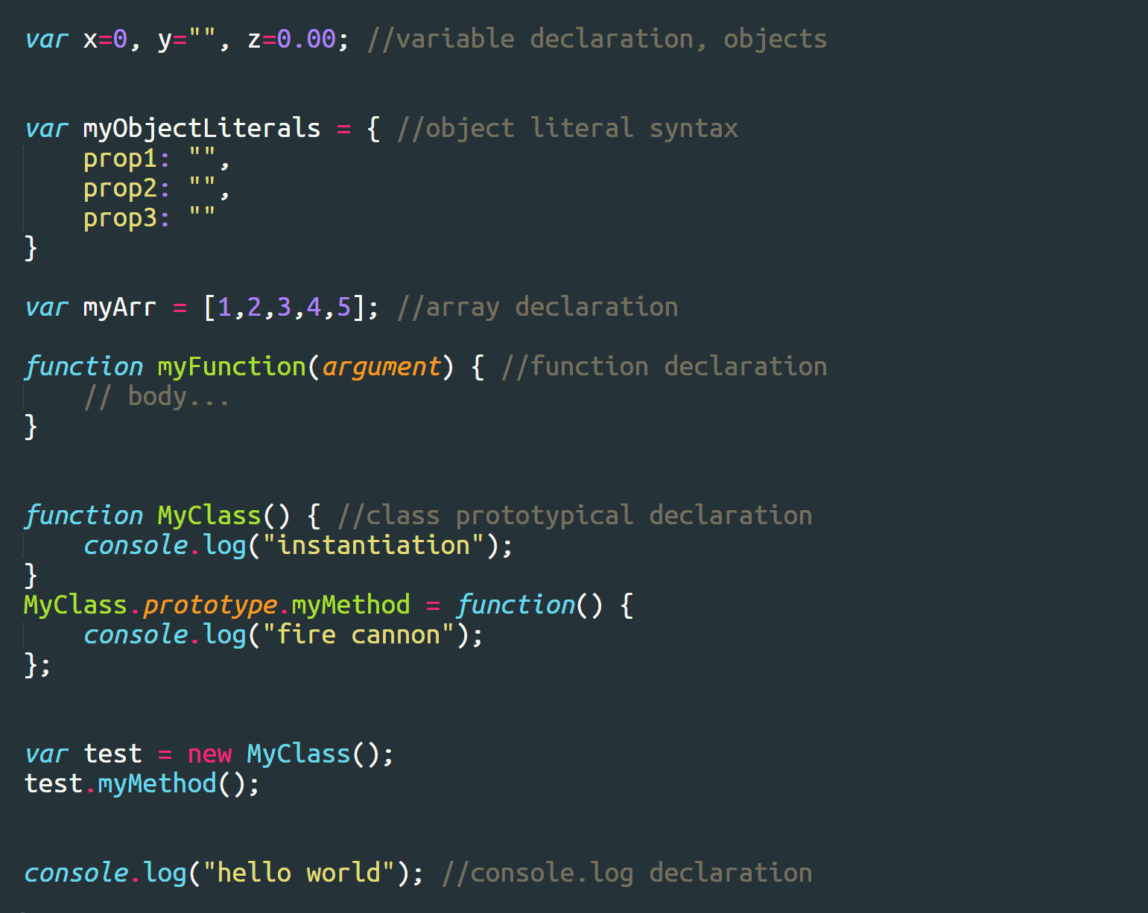
Basic Syntax
Notes:
When you add a prototype to your function, it becomes a class you can instantiate

Slide 10
What is ECMAScript? What’s that?
“Such standards would make it possible to use data prepared for, or even by, a computer made by one manufacturer to be on a computer made by another with the minimum of alteration. Also it would avoid duplication of work in the preparation of, for example, programming languages by several manufacturers.”
-ECMA International
An organization that was created to standardize JavaScript
ECMAScript is commonly used for client-side scripting on the World Wide Web, and it is increasingly being used for writing server applications and services using Node.js
Source: https://www.ecma-international.org/memento/history.htm

Slide 11
How ES2015/ES6 syntax improves the current structure of JavaScript
Improved Array helper methods
Enhanced Object Literals
The Rest Operator
The Spread Operator
Destructuring
Improved Class construction than using prototypical class
Generators

Slide 12
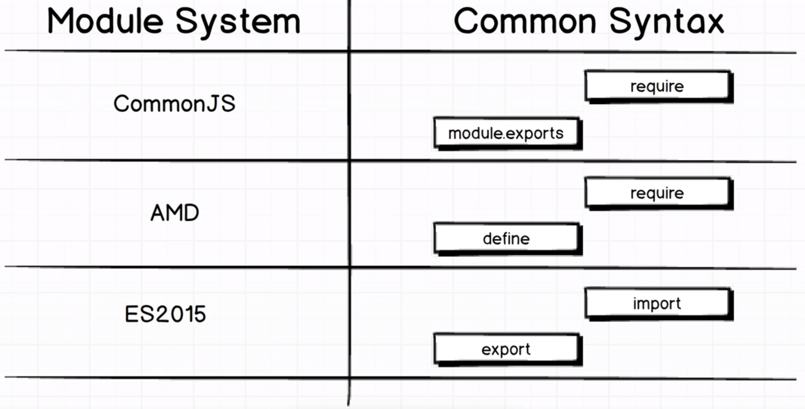
The Module System

Slide 13
The challenge of Modern Web Development

Slide 14

JavaScript is confusing

Slide 15







What JavaScript libraries to use
Go to github and look for libraries with lots of community support
Learn what are your needs for development

Slide 16
Single Page Applications
Processes requests by user in just one page
Renders some of user request without full page load

Slide 17
How Single Page Application works
Server responds and returns a JSON format for JavaScript to process and render in specific areas of webpage
APIs
User Interaction
Web Page
APIs
Server
APIs
AJAX requests
API talks to the server

Slide 18
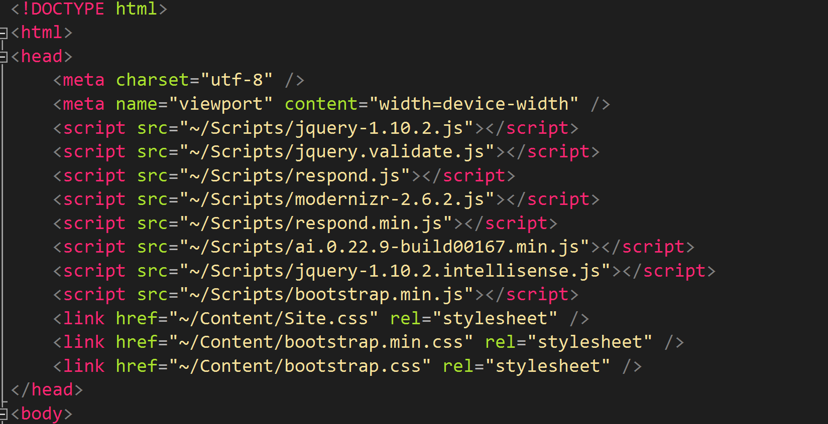
Bundling Javascript libraries / packages

Slide 19
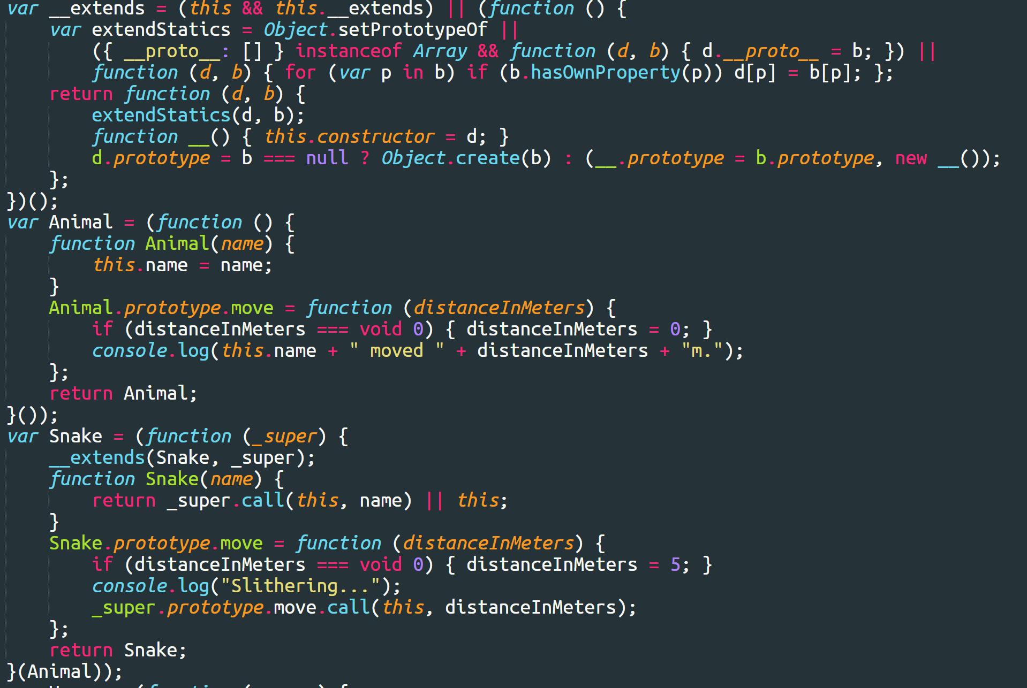
The problems with vanilla javascript
Notes:
That’s why we use JS libraries and frameworks to streamline and standardize the process of developing javascript. Also, it gives us better structure and strong foundation.

Slide 20
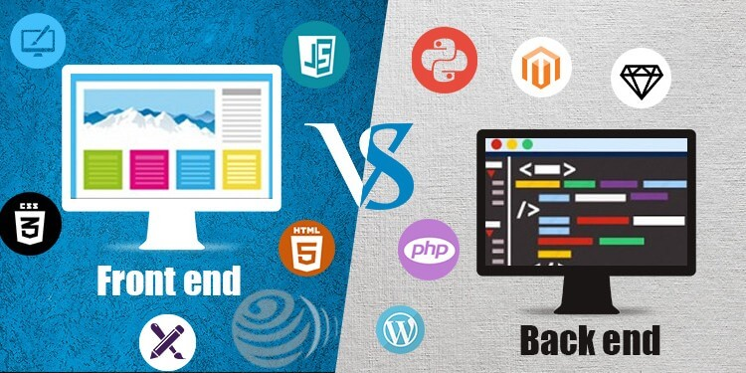
Front-end and Back-end
Notes:
Front end – Responsible for UI
Back end – Responsible for talking to database server and in hosted server

Slide 21
The solution to Modern Web Development

Slide 22




Javascript library package managers and bundlers

Slide 23
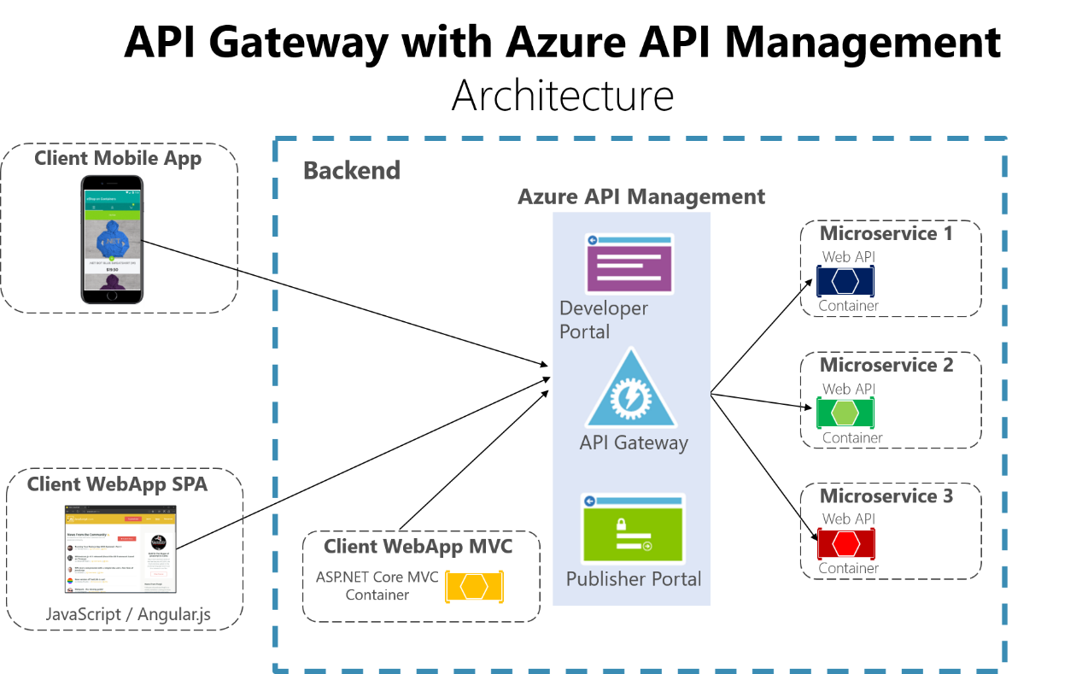
RESTful-services API architecture for back-end
Notes:
Lots of buzzwords nowadays like Microservices, APIs and stuff

Slide 24
What is Webpack?

Slide 25
What is Webpack?
At its core, webpack is a static module bundler for modern JavaScript applications. When webpack processes your application, it internally builds a dependency graph which maps every module your project needs and generates one or more bundles.
Notes:
https://webpack.js.org

Slide 26
Part 2: Getting Started in React with Laravel API endpoints

Slide 27
What is ReactJS?

Slide 28
What is ReactJS
Is a JavaScript library for building user interfaces
Is a view layer that focuses on actions, state, component lifecycle
Notes:
My mistake when trying to combine MVC with ReactJS and thinking in MVC while using ReactJS

Slide 29
What is React trying to solve?

Slide 30
What is React trying to solve
Component-based paradigm instead of manipulating DOM directly
HTML inside JavaScript (JSX syntax)
Each Component has its own lifecycle
Components maintain their own “state”
Event-driven components
Rendering performance
Notes:
Not entirely an HTML inside JavaScript but rather a JSX syntax

Slide 31
ReactJS Philosophy

Slide 32
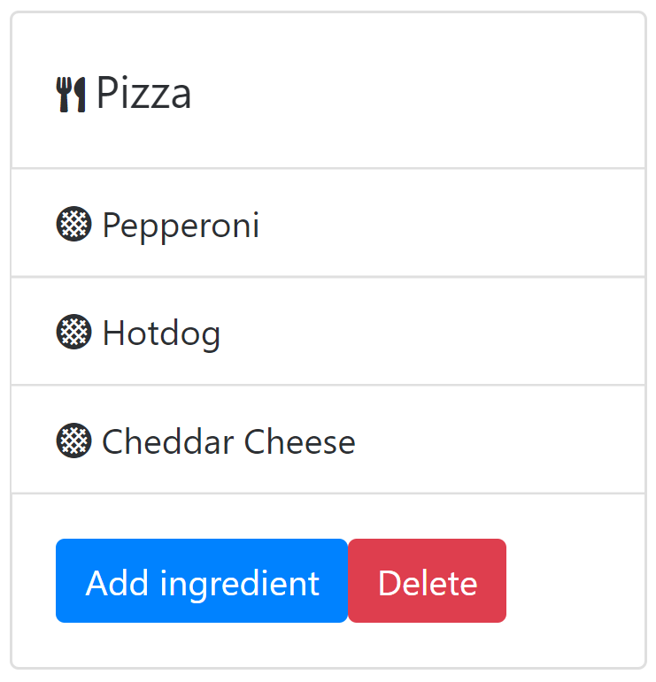
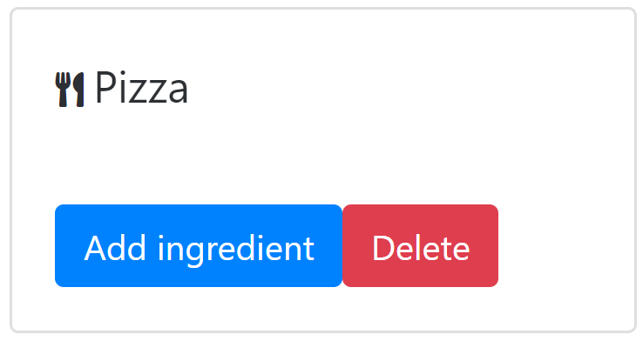
ReactJS design philosophy explained
Hover
Actions
On click
State change
Mouse enter
Leave controls
Form submit
Initially rendered component
User Interaction
Re-rendered component
Notes:
State change is caused by user interaction
Component will re-render itself when the state is changed. This is done under the hood
What I like in React is it focuses on actions and state, therefore improving the User Experience when using the web app

Slide 33
JavaScript libraries nowadays
HTML
CSS
JavaScript
Component

Slide 34
Notes:
UI as a “component” instead of treating every individual file as html/css/javascript. Show an image showing the component structure
Show some samples of doing the DOM Manipulation using jQuery from React
https://codesandbox.io/s/3x840xqrx6 -> jquery playground
https://codesandbox.io/s/o5ww2xzx2q -> react playground

Slide 35
Advantages of using React

Slide 36
Advantages of using React
Each component has its own state and lifecycle to retain data or information
Each component has its own actions that allows User interaction seem fluid
Total flexibility of the ecosystem
Encourages functional way of doing things (immutable data)
It’s closer to vanilla javascript

Slide 37
Cons of using React

Slide 38
Cons of using React
You need transpiler like Babel to use JSX syntax
You need to learn webpack to set everything up
The library encourages “you’re on your own”
The code could get unmanageable if not architected properly
Hard to build your own starting project from scratch
Solution: Use boilerplate like create-react-app
Notes:
Show how JSX compiles into plain javascript
Tell my struggles in using the ecosystem last 2015
Basically if I want to dig deeper in webpack and babel, I would choose ReactJS

Slide 39
The basics of React

Slide 40
The basics of React
JSX Syntax
Rendering Elements in DOM
Component Lifecycle
Types of state
Component Props

Slide 41
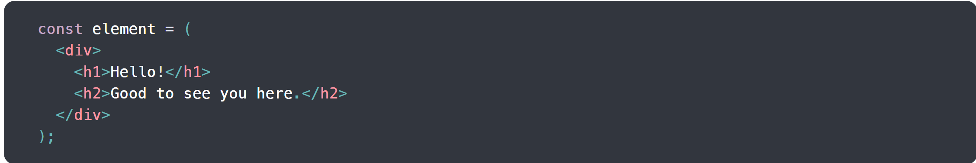
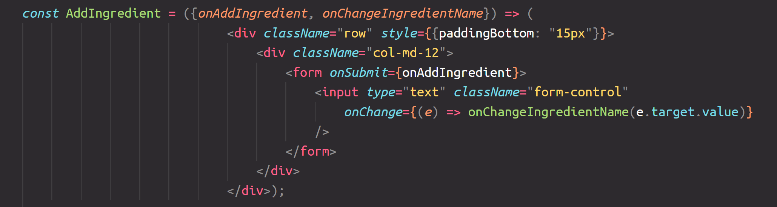
JSX Syntax
Notes:
Why JSX and not HTML?

Slide 42
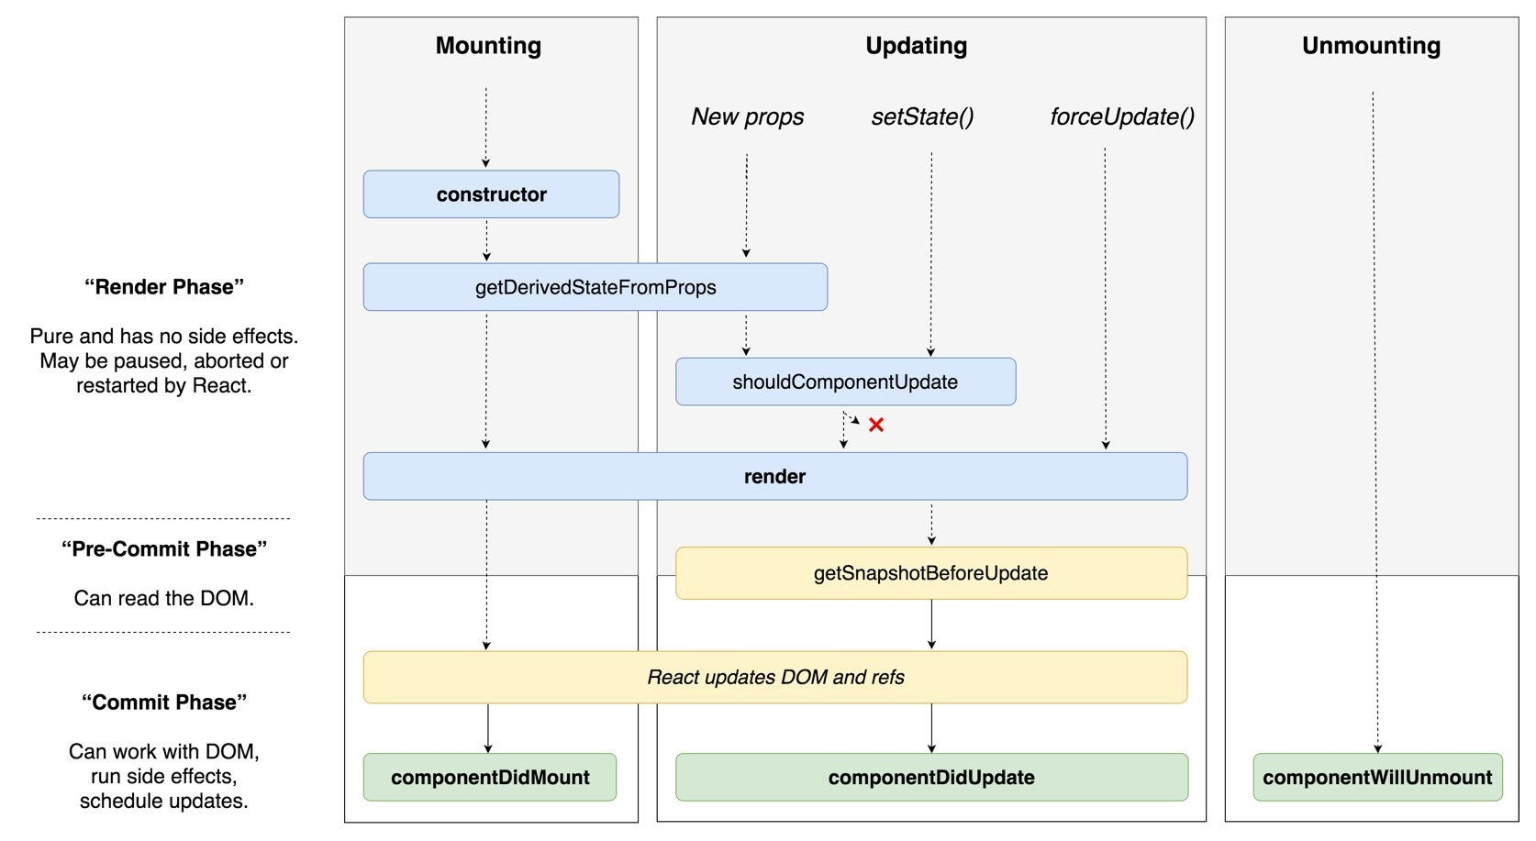
React Component Lifecycle
Notes:
If we’re going to change the state, components will be re-rendered to show the updated state in the UI
It’s worthy to take note that only Class-based components maintains their own lifecycle. Functional-based component’s doesn’t have its own lifecycle

Slide 43
Types of State
Component-level state (using Class Components)
Application-level state (using libraries like Flux, Redux, MobX, and other state management libraries)

Slide 44
State explained
Component-level State
Application Level State
Component
State
State
Component
State
State
Component
Component
State
Component
Notes:
Other libraries are starting to catch up in the “state” pattern
Application-level state where the state is the center of the pattern so 2 or more components can reuse the same state and use it for rendering purposes
Application-level state needs libraries like Redux

Slide 45
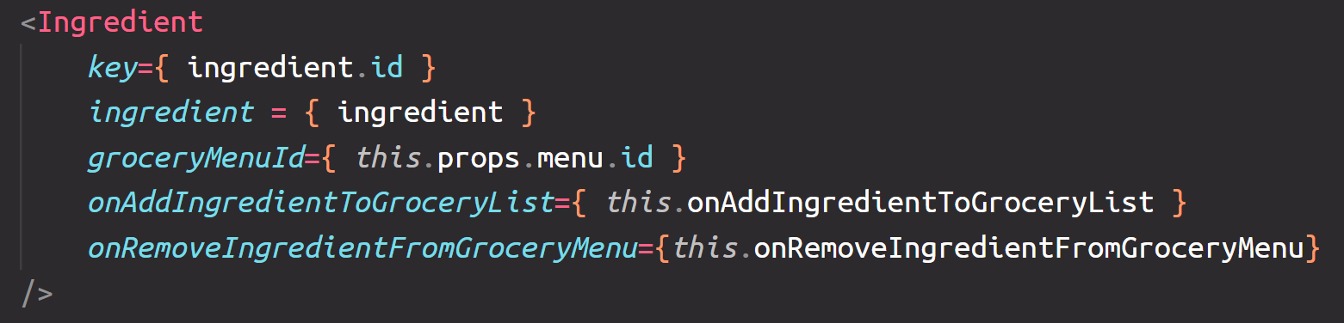
Component Props
Notes:
Props stands for “properties”
Each component has properties of its own that we can set to pass the values/data within the child component.

Slide 46
Quickstart with building React applications

Slide 47
Quickstart with building React applications
Configuring Webpack Mix to use ReactJS
Installing npm packages for react
Running npm and php artisan simultaneously

Slide 49
Creating our first React Application

Slide 50
Some key notes
For installing packages
Npm install -> For React project
Composer install -> For Laravel project
For running the Project
Npm run watch -> For compiling javascript files
Php artisan serve -> For running Laravel project

Slide 51
Creating our first React Application
Functional Component
Class-based Component
Changing the state
Controlled component
Naming conventions for React projects
Notes:
When a component's value is set by a state, it's called a controlled component
Naming conventions – small camelCase for functions/helper methods, and big CamelCase for React components
Avoid assigning state to a value directly. Use setState()

Slide 53
Developing CRUD apps using ReactJS
Notes:
Folder structure:
ReactJS01-Setting-REST-Services
ReactJS02-Applying-Add-Functionality
ReactJS03-Rendering-Menu-Delete-Functionality
ReactJS04-Rendering-MenuIngredient-Delete-Functionality
ReactJS05-Rendering-Grocery-Ingredient-Lists-AddDelete

Slide 54
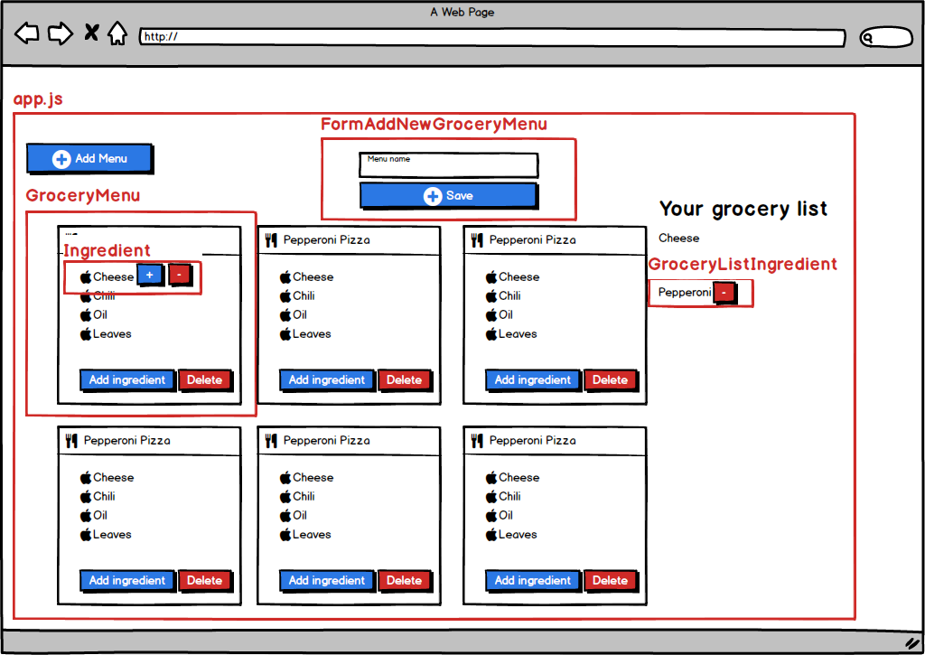
Notes:
The top of the component hierarchy is app.js

Slide 55
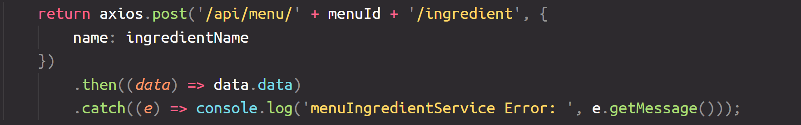
Setting up RESTful services from Laravel API
Install a library called Axios to initiate ajax requests
Wrap it up in service function to reuse it later
Notes:
Since ajax calls are asynchronous by nature, we still need to call .then() when it’s done processing

Slide 57
Applying Add Menu functionality

Slide 59
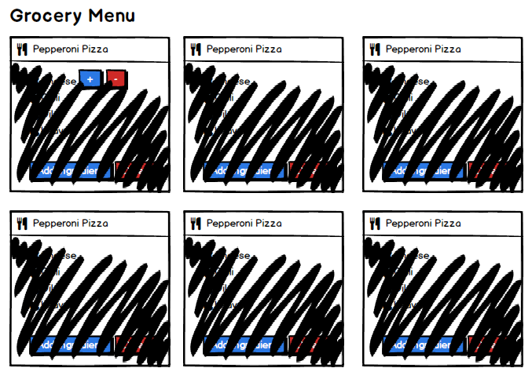
Rendering the Menu Lists with delete functionality

Slide 60
Using props to fire events in parent component
App.js
We set the state in renderLists
We assign renderLists to onDelete props in GroceryMenu component
When the onDelete is triggered, renderLists will also be triggered
renderLists
GroceryMenu
onDelete
Notes:
Trigger the event inside the child and attach the props in parent component to initiate re-rendering

Slide 61
Notes:
Try to explain some constraints when the child component deletes a data, particularly since the state for Grocery Menu is in App.js component

Slide 62
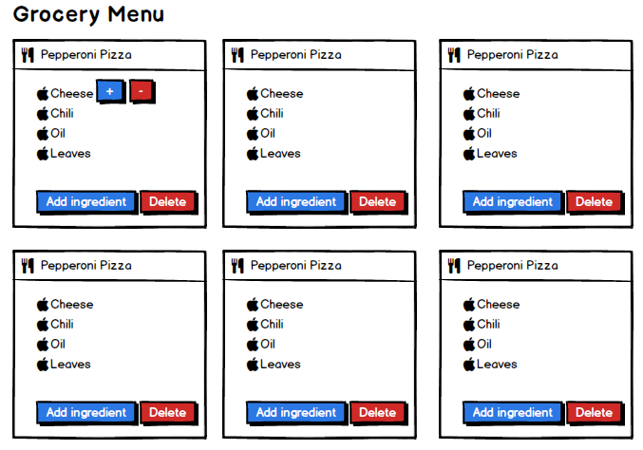
Render Menu Ingredients with Add/Delete functionality
Notes:
Add an ability to render list of ingredients, add/delete an ingredient from menu
Adding an ingredient to Grocery Lists is on the next lesson

Slide 64
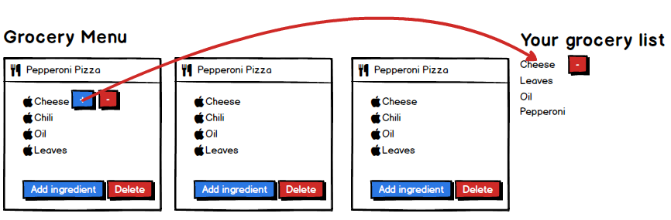
Rendering Grocery Ingredient lists with add/delete

Slide 66
Part 3: Where to go from here?

Slide 67
Recommended course/MOOC sites for self-paced learning

Slide 68
Course sites
Udemy
Pluralsight
Treehouse
Microsoft Virtual Academy
Code School
FreeCodeCamp
Youtube

Slide 69
Recommended courses for ReactJS, Laravel, Webpack

Slide 70
Courses
https://www.udemy.com/webpack-2-the-complete-developers-guide
https://www.udemy.com/react-redux

Slide 71
Advices for Developers

